Slide 1
CEO compensation: Evidence from the field
Alex Edmans
London Business School
Tom Gosling
London Business School
Dirk Jenter
London School of Economics and Political Science
Journal of Financial Economics
Oct 2023
Presented by: Yan Li

Slide 2
Research Goal
The first goal is to understand the objectives and constraints of contract design, and thus the underlying program. The second goal is to identify the determinants of pay, by investigating factors that theories deem relevant but are unobservable, or that prior models have overlooked.

Slide 3
Related Literature
This paper builds on the literature on CEO compensation, reviewed by Murphy (2013), Edmans and Gabaix (2016), and Edmans et al. (2017).
It is also related to other corporate finance surveys, such as Graham and Harvey (2001), Graham et al. (2005), Brav et al. (2005), Ben-David et al. (2013), and Graham et al. (2013).
A unique feature is that the authors of this paper survey both directors and investors. The above papers study executives only; others, such as McCahery et al. (2016), Krueger et al. (2020), and Gompers et al. (2020), study investors only. CEO pay is arguably the corporate decision on which investors have the greatest influence, given say-on-pay, and thus an interesting setting to compare their views with directors.

Slide 4
Data Description and Univariate Analysis
The researchers distributed survey in late 2020, receiving responses from 203 non-executive directors of FTSE All-Share companies and 159 institutional investors in UK equities. Most questions allowed respondents to add free-text comments, and 14 post-survey interviews were conducted.

Slide 5
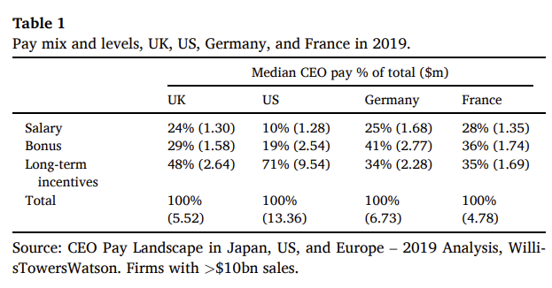
The UK context and COVID-19
Reasons to study executive pay in the UK:
First, the UK is between the US and continental Europe in both the level and structure of pay, suggesting that it is not an outlier
Second, the UK does not have any differential tax treatments that would cause a preference for one form of pay over the other (unlike, for example, Section 162(m) in the US which, before 2018, exempted qualified performance-based pay from the $1 million cap on tax deductibility), nor do accounting or disclosure rules have material asymmetric impacts. Thus, any findings are unlikely to be due to tax, accounting, or disclosure factors that are specific to the UK.
Third, the UK has a relatively settled regulatory regime surrounding executive pay, and UK investors have significant experience in evaluating, voting on, and engaging on CEO pay
Fourth, on a practical level, the authors are from well-known UK universities, increasing the likelihood that UK directors and investors would respond to an academic survey

Slide 6
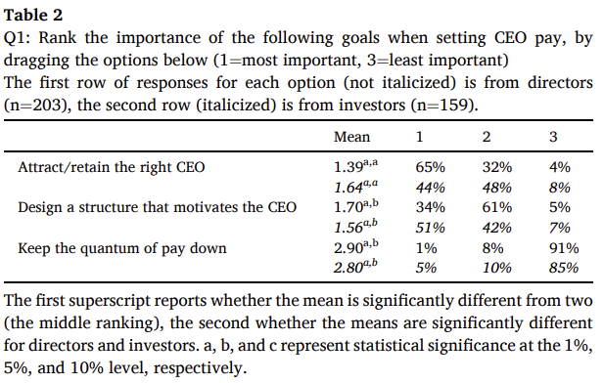
The objectives of CEO pay design
The standard CEO pay model described involves three objectives, assuming a given effort level: (1) minimizing the level of pay subject to (2) the structure inducing the required effort level (i.e., the IC being satisfied) and (3) the CEO accepting the contract (i.e., the IR being satisfied).
Table 2 illustrates the results. Both directors and investors view minimizing the level of pay (“keep the quantum of pay down”) as least important, with 91% of directors and 85% of investors ranking it last

Slide 7
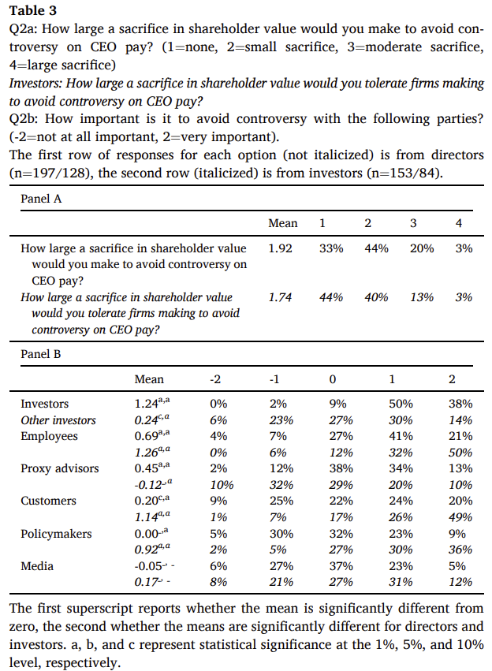
The constraints of CEO pay design
67% of directors would sacrifice shareholder value to avoid controversy, and 56% of investors would tolerate directors doing so. This suggests that boards and investors feel restricted by far more than the IR and IC.
88% of directors deem it important to avoid controversy with investors; this response also received by far the highest average rating (1.24). Directors rated employees as the second most important source of controversy (63%/0.69).
Shareholders, on the other hand, believe the main sources of controversy to be employees (82%/1.26), customers (75%/1.14) and policymakers (65%/0.92)

Slide 8
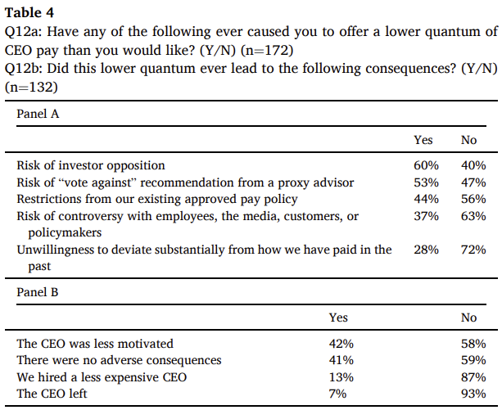
Constraints and the level of pay
Notes:
60% offered less pay to avoid the “risk of investor opposition,” and 53% to avoid the “risk of ‘vote against’ recommendation from a proxy advisor.” A minority feel constrained by the existing shareholder-approved pay policy (44%), the need to avoid controversy with employees, the media, customers, or policymakers (37%), or past pay practices (28%).
Only 7% reported that the CEO left, and 13% that they hired a less expensive CEO. The most popular responses are not predicted by standard theories. 42% of directors reported that “the CEO was less motivated.” The second-most reported effect of lower pay was “there were no adverse consequences” (41%).

Slide 9
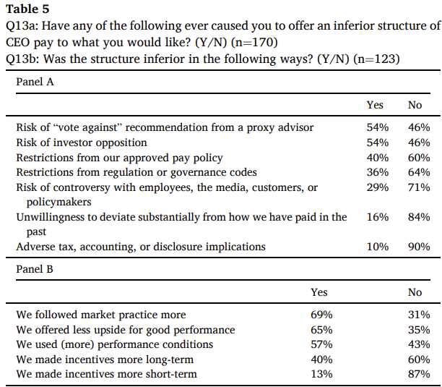
Constraints and the structure of pay
Notes:
72% of directors were forced to offer an inferior pay structure, mostly because of proxy advisors (54%) or investors (54%). To the 72% of respondents who selected “Yes” to at least one constraint, Panel B asked “Was the structure inferior in the following ways?” 69% responded that they had to “follow market practice more,” likely to comply with one-size-fits-all rules applied by investors or proxy advisors.
65% of directors were forced to offer less upside for good performance. 57% of directors were forced to use more performance conditions.

Slide 10
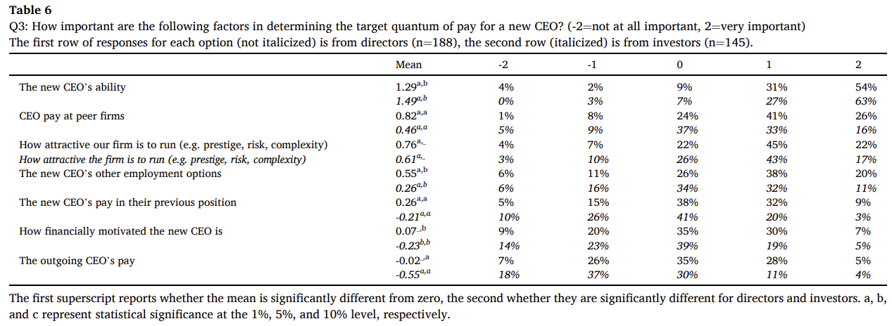








Pay of a new CEO
The new CEO’s ability” ranked first for both directors (85%/1.29) and investors (90%/1.49). Many critics of high pay believe that the CEO job involves little disutility, so it should not be a significant driver of pay. In contrast, this response ranked second for investors (61%/0.61) and third for directors (68%/0.76).
Notes:
“CEO pay at peer firms” was the second most popular response for directors (66%/0.82) and third for investors (49%/0.46). Both ranked it higher than “the new CEO’s pay in their previous position” (42%/0.26 for directors and 23%/-0.21 for investors) and “the new CEO’s other employment options” (58%/0.55 and 43%/0.26), which more directly reflect the CEO’s outside alternatives. This suggests that pay at peer firms is important beyond the participation constraint, and is relevant even if the CEO could not move to those firms.

Slide 11
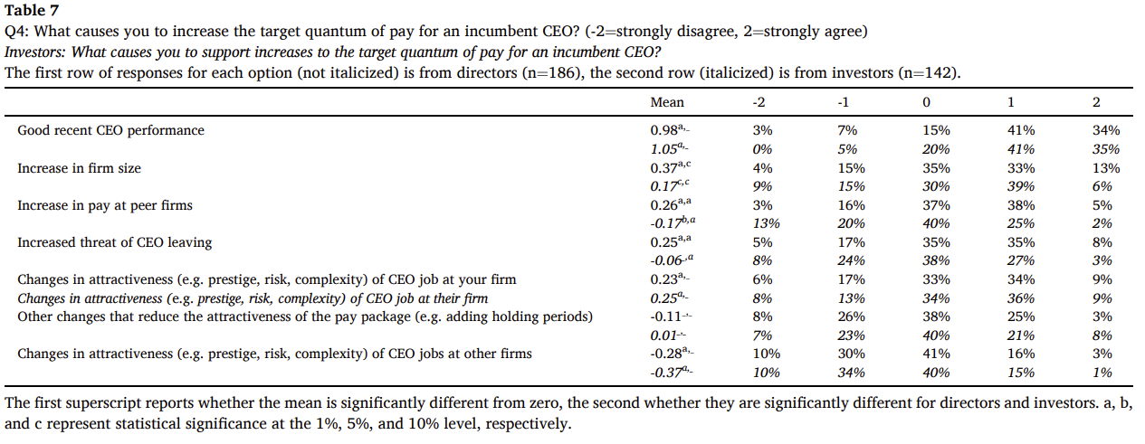











Increases in pay for an incumbent CEO
Notes:
Both rated “good recent CEO performance” the highest, with support of 76%/0.98 from directors and 75%/1.05 from investors. The results suggest that changes in flow pay play a special role by addressing CEOs’ desire for recognition. A pay increase, unlike the revaluation of equity, provides internal recognition because it requires a discretionary decision by the board and approval by shareholders. It provides external recognition because it is observable and thus boosts the CEO’s reputation.
All other responses received less than 50% support from both groups. The second most common response from directors was “increases in firm size” (46%/0.37; 45%/0.17 from investors). Directors ranked “increases in pay at peer firms” (44%/0.26) significantly higher than investors (27%/-0.17). Because CEOs are rarely hired away (Cziraki and Jenter, 2022), this is more likely due to directors being attuned to the importance of fairness in motivating CEOs rather than labor market pressures. The responses to “other changes that reduce the attractiveness of the pay package (e.g. adding holding periods)” (25%/-0.11 for directors and 30%/0.01 for investors) is low.

Slide 12
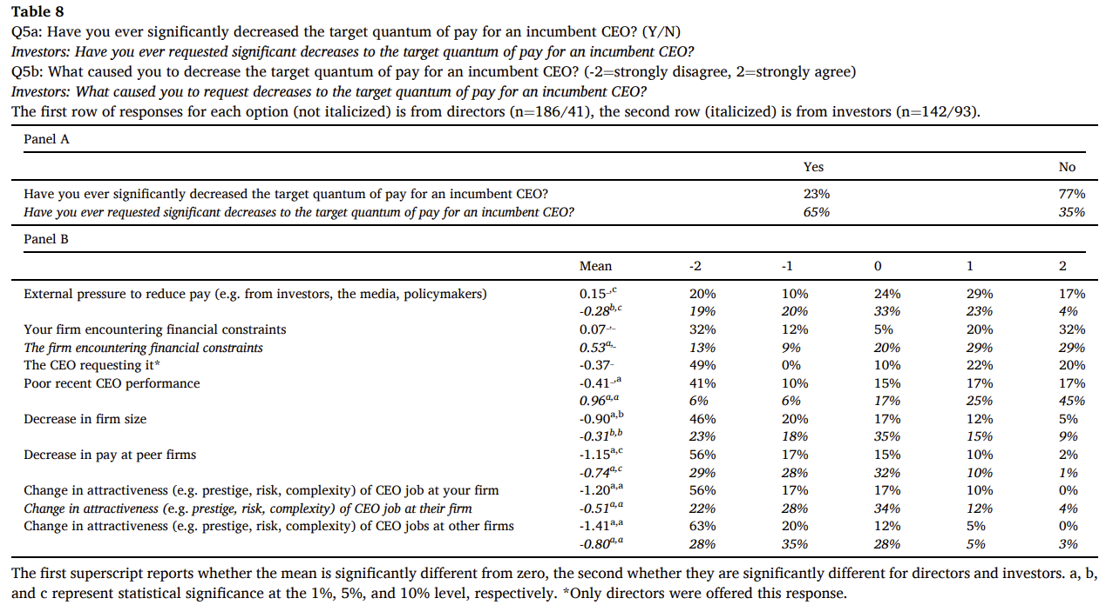



Decreases in pay for an incumbent CEO
Notes:
Only 23% of directors responded “Yes.” to the question “Have you ever significantly decreased the target quantum of pay for an incumbent CEO?”. Combined with the difficulty of significantly increasing pay, this suggests that CEO pay is sticky, and that directors decide pay changes rather than pay levels.
To the respondents who answered “Yes,” Panel B asked “What caused you to decrease the target quantum of pay for an incumbent CEO?” The five factors that standard theories predict should drive reductions in pay (poor performance, decreases in firm size, changes in attractiveness at your firm, changes in attractiveness at other firms, decreases in pay at peer firms) were the five least popular options for directors, all with negative average ratings. In contrast, investors believe that these five factors should drive both increases and decreases in pay, as theory predicts.
Directors’ three most common reasons to cut pay: external pressure to reduce pay; your firm encountering financial constraints; the CEO requesting it.

Slide 13
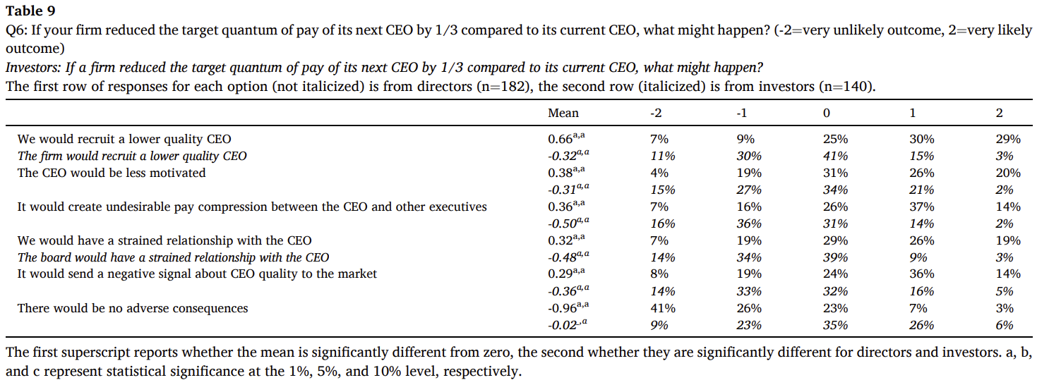
Why is CEO pay so high?
Notes:
Only 10% of directors agreed that “there would be no adverse consequences” (average score -0.96). Their strongest concern was “we would recruit a lower quality CEO” (59%/0.66). Directors’ second greatest concern was “the CEO would be less motivated” (46%/0.38), suggesting that the level of pay has motivational consequences missing from standard models. Just over half agreed that “it would create undesirable pay compression between the CEO and other executives” (51%/0.36), another concern absent from most models, which focus on CEO pay in isolation.
In contrast, investors are much more open to cutting CEO pay than directors. Their most popular response was that “there would be no adverse consequences” (33%/-0.02, with 35% neither agreeing nor disagreeing). Fewer than a quarter agreed with each of the negative consequences. Thus, many investors believe it is possible to reduce CEO pay by as much as 1/3.

Slide 14
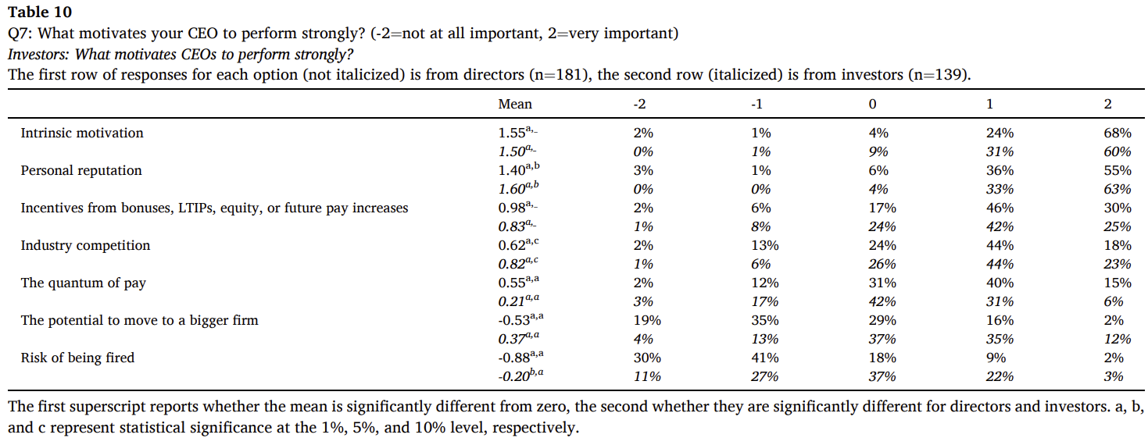
What motivates a CEO?
Notes:
Most models assume that financial incentives are the only motivator. However, while the support for “incentives from bonuses, LTIPs, equity, or future pay increases” was high (76%/0.98 for directors and 68%/0.83 for investors), it was only the third highest-rated response from both groups. Instead, directors and investors agree that by far the strongest drivers of CEO effort are “intrinsic motivation” (92%/1.55 for directors and 91%/1.50 for investors) and “personal reputation” (91%/1.40 and 96%/1.60), suggesting that simply being seen to do a good job is important. “The quantum of pay” (55%/0.55 for directors, 37%/0.21 for investors) is seen as another important motivator, inconsistent with most theory models but consistent with the importance of fairness.
Even though career concerns have been a focus of the literature on CEO incentives since Fama (1980), they are not seen as important, especially by directors. “The potential to move to a bigger firm” received support of only 18%/-0.53 from directors (46%/0.37 from investors), and the “risk of being fired” of only 11%/-0.88 (25%/-0.20).

Slide 15
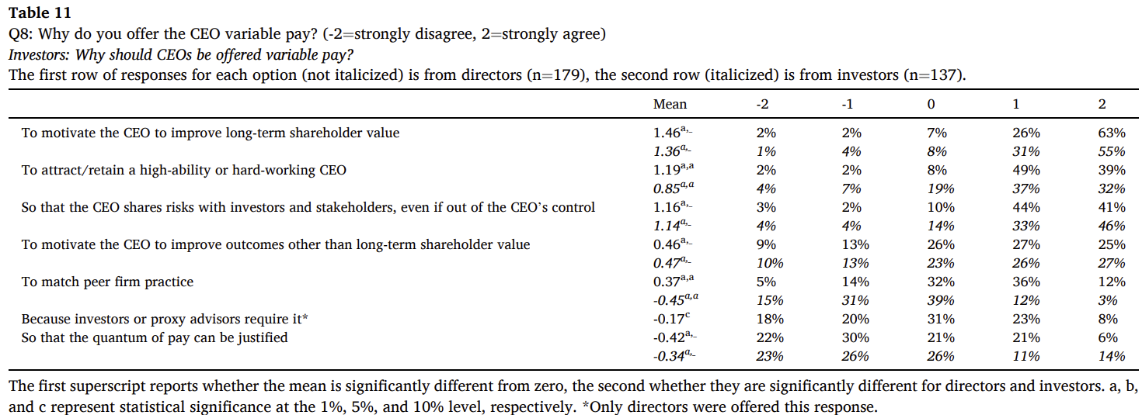
The motivation for variable pay
Notes:
“to motivate the CEO to improve outcomes other than long-term shareholder value.” received only modest support (52%/0.46 from directors and 53%/0.47 from investors), despite environmental, social, and governance (“ESG”)-linked pay becoming increasingly frequent. Directors (49%/0.37) assigned significantly greater importance than investors (15%/-0.45) “to match peer firm practice.”, suggesting that many investors appreciate heterogeneity – thus, directors may have more latitude to tailor the structure of pay than they think.

Slide 16
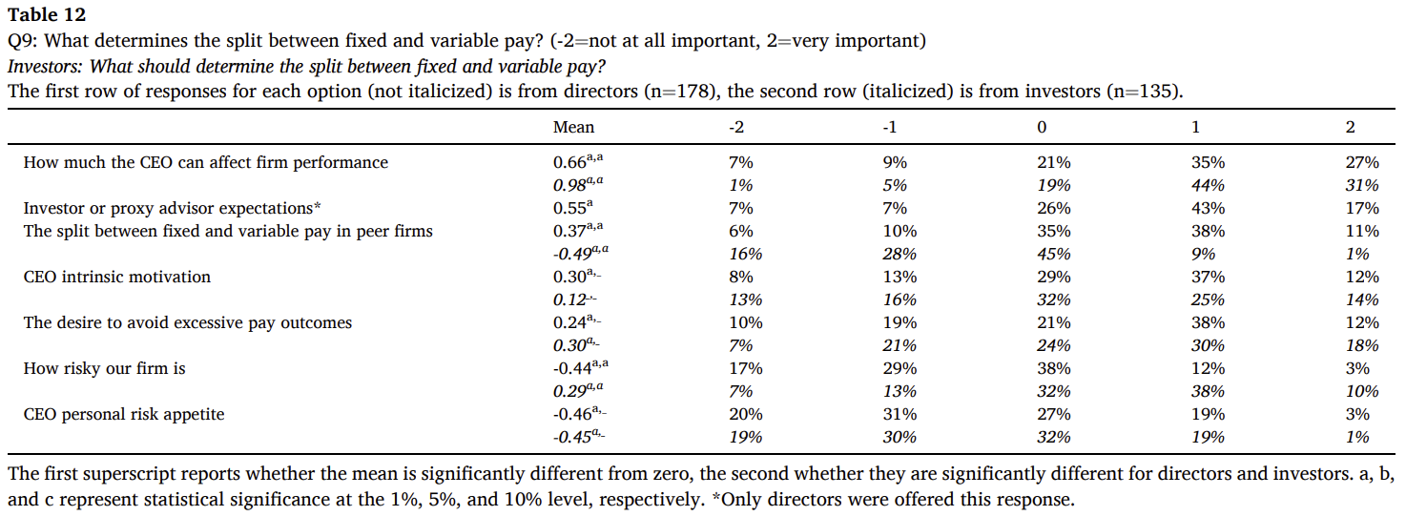



The determinants of variable pay
Notes:
The lowest responses were “CEO personal risk appetite” (22%/-0.46 for directors and 20%/-0.45 for investors) and “how risky our firm is” (16%/-0.44 and 47%/0.29). These are key drivers of incentives in classic models– the higher firm risk and CEO risk aversion, the greater the compensating differential the CEO requires for variable pay. However, if the motivation for rewarding good performance is recognition and fairness, this trade-off is moot; instead, pay variability is driven by what is perceived to be the fair reward for performance. The most popular response was “how much the CEO can affect firm performance” (62%/0.66 for directors and 75%/0.98 for investors).
The next two most popular responses from directors are not predicted by standard models: “investor or proxy advisor expectations” (60%/0.55) and “the split between fixed and variable pay in peer firms” (49%/0.37). Thus, many directors do not set incentives from first principles but follow market practice

Slide 17
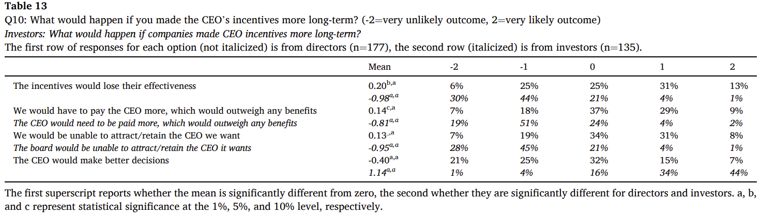


Long-term incentives
Notes:
the most popular response from investors was “the CEO would make better decisions” (78%/1.14). The three responses that suggest negative consequences – “the incentives would lose their effectiveness”, “we would have to pay the CEO more, which would outweigh any benefits”, and “we would be unable to attract/retain the CEO we want” – all scored below -0.8. Directors strongly disagree. “The CEO would make better decisions” obtained the weakest response (22%/-0.40), and 63% of directors agreed with at least one of the three concerns. This discrepancy between investors’ stated preferences and directors’ views of those preferences is interesting and echoes the mismatch on investors’ preferences for tailoring.

Slide 18
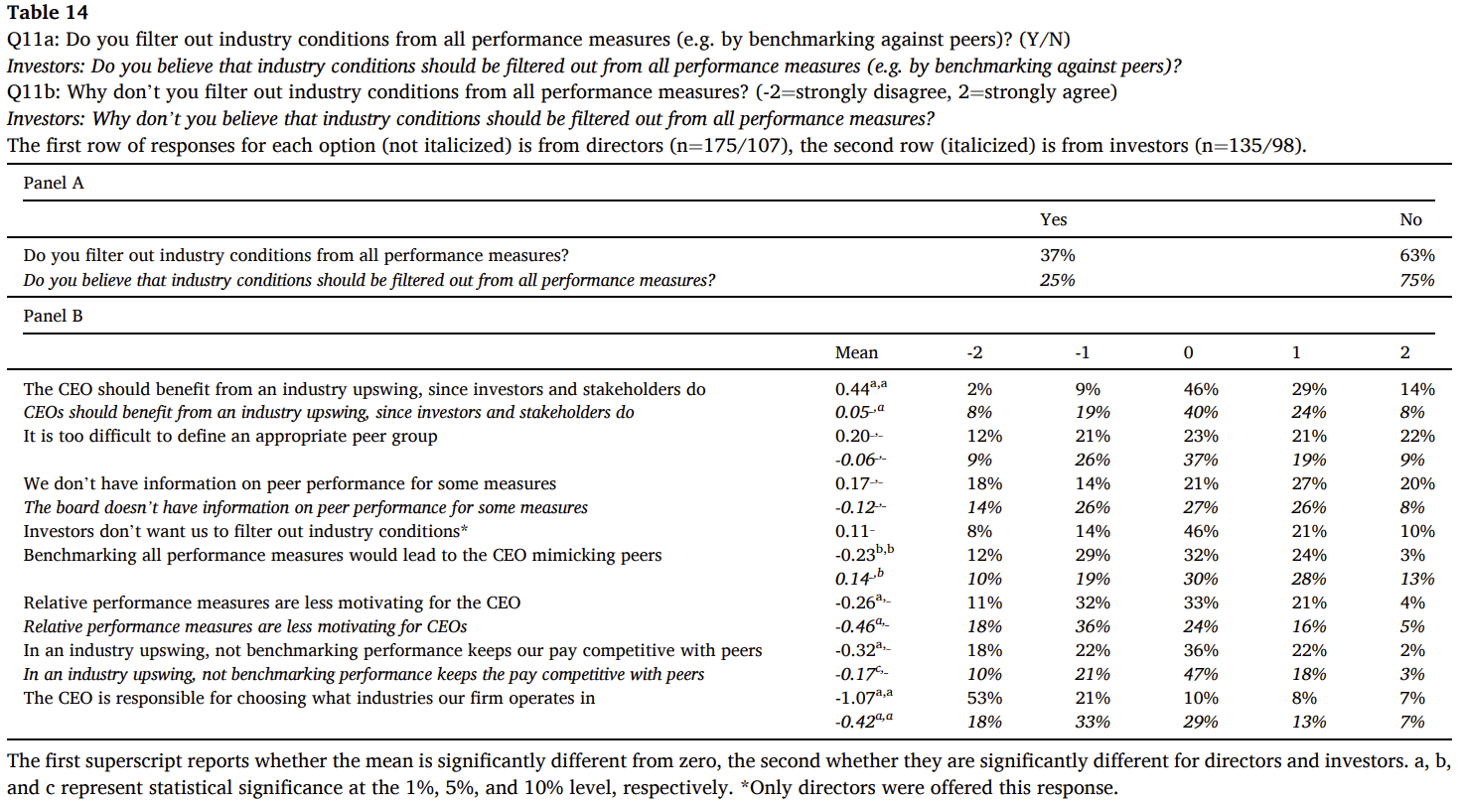
Relative performance evaluation
Notes:
Panel A asked, “Do you filter out industry conditions from all performance measures (e.g. by benchmarking against peers)?” 63% of directors and 75% of investors responded “No.” To those respondents, Panel B asked why they do not universally benchmark. The most popular answer among directors (43%/0.44, versus 33%/0.05 from investors) was that “the CEO should benefit from an industry upswing, since investors and stakeholders do.” This contradicts efficient risk-sharing, but is consistent with fairness.
The next two highest responses from directors were “It is too difficult to define an appropriate peer group” (43%/0.20, 29%/-0.06 for investors) and “We don’t have information on peer performance for some measures” (47%/0.17, 34%/-0.12 for investors).
Investors responded most positively to “benchmarking all performance measures would lead to the CEO mimicking peers” (41%/0.14, versus only 27%/-0.23 for directors)

Slide 19
Conclusions
1. Directors and investors consider intrinsic motivation and personal reputation to be the most important sources of incentives for CEOs.
2. The primary reason for variable pay is to motivate the CEO to improve long-term shareholder value, as variable pay provides ex-post recognition of performance, addressing the CEO’s fairness concerns and preserving her intrinsic motivation.
3. The main determinant of pay variability is how much the CEO can affect firm performance. Firm risk and CEO risk aversion are not important. Directors feel constrained by peer firm practice and investor and proxy advisor expectations, hindering them from tailoring pay – even though investors do not consider following peer practice as important.
4. Investors believe that lengthening the horizon of CEO incentives would improve decisions, with few adverse consequences. Directors disagree. Some are concerned about the attraction/ retention effects of such a change; others believe that incentives would become less effective.
5. Most directors and in particular investors do not believe that benchmarking of CEO performance measures should be universal.

Slide 20
Thank you!

